Slide 1

Redistricting Data Program
Presentation to the Texas Senate Select Committee on Redistricting
10/29/2019
James Whitehorne
Chief – Census Redistricting & Voting Rights Data Office

Slide 2
Agenda
  The Census Role in Redistricting
    Public Law 94-171
    2020 Redistricting Data Program
  Timing
    2018 Prototype P.L. 94-171 Redistricting Data
    2020 P.L. 94-171 Redistricting Data
  Products
    2020 Census Geographic Products
    2020 Census Tabulations
  Voting Rights Tabulations
    Citizen Voting Age Population by Race and Ethnicity (CVAP) special tabulation
    Section 203 of the Voting Rights Act

Slide 3
Public Law 94-171
Mission: Provide the officers or public bodies having initial responsibility for the legislative apportionment or districting of each State an opportunity to identify the geographic areas for which specific tabulations of population are desired and to deliver those tabulations in a timely manner.
Identified “geographic areas desired”:
Census Tabulation Blocks
Voting Districts (e.g. precincts, wards, etc.)
Legislative and Congressional Districts
Requirements:
Establish program criteria
Identify required tabulations
Conduct the program in a non-partisan manner
Deliver the tabulations to the governor and the officers or public bodies having initial responsibility for the legislative apportionment or districting of each State no later than 1 year from Census Day (April 1, 2021)

Slide 4
2020 Redistricting Data Program
Phase 1 – The Block Boundary Suggestion Project (BBSP)
Phase 2 – The Voting District Project (VTDP)
Phase 3 – Data Delivery
Phase 4 – Collection of the new plans
  118th Congressional Plans
  New State Legislative District Plans
Phase 5 – The View From the States
  The evaluation of the 2020 Redistricting Data Program (RDP), the recommendations from the states, and the plan for the 2030 RDP

Slide 5
Timing
Phase 3 – Prototype Data
Phase 3 – Official Data
Activity | Date
Prototype geographic support products | Delivered: February
Prototype P.L. 94-171 Redistricting Data | Delivered: March 28, 2019
Activity | Date
Geographic support products | Late November 2020 – February 1, 2021
P.L. 94-171 Redistricting Data | February 18, 2021 – March 31, 2021

Slide 6
Products
Phase 3 – Geographic Products
Shapefiles – geographic information system geometry files
Maps (PDF only) – County Block; Voting District/State Legislative District; Tract; School District
Block Assignment Files – tables identifying the blocks used to build different geographic entities
Block to Block Relationship Files – Crosswalk of 2010 blocks to 2020 blocks
2018 Prototype | 2020 Official
Shapefiles | Shapefiles
Maps | Maps
Block Assignment Files | Block Assignment Files
 | Block to Block Relationship Files

Slide 7
Products
Phase 3 – Tabulations
Prototype P.L. 94-171 Redistricting Data File
Multiple geographies including census block
Group quarters is total population only, no demographic breakdown
Final 2020 P.L. 94-171 Redistricting Data File design is the same as the prototype dataset
  Change to the summary file geoheader – pipe delimited rather than fixed width
Final 2018 Prototype P.L. 94-171 Redistricting Data File Design
Table P1 – Race
Table P2 – Race for the Population 18 Years and Over
Table P3 – Hispanic or Latino, and not Hispanic or Latino by Race
Table P4 – Hispanic or Latino, and not Hispanic or Latino by Race for the Population 18 and Over
Table H1 – Occupancy Status (Housing)
New Table
Table P5 – Group Quarters Population by Group Quarters Type

Slide 8
Voting Rights Tabulations
Citizen Voting Age Population by Race and Ethnicity
Annual Tabulation
Calculated using the American Community Survey 5-year estimates
Added Congressional and State Legislative Districts for 2018 and future releases
Typically released in the 1st week of February each year
Section 203 Language Determinations
New determinations conducted every 5 years
Identifies counties or townships where language assistance is needed for voting
Calculated using the American Community Survey 5-year estimates
Last published in the Federal Register –12/5/2016, next publication estimated 12/2021

Slide 9
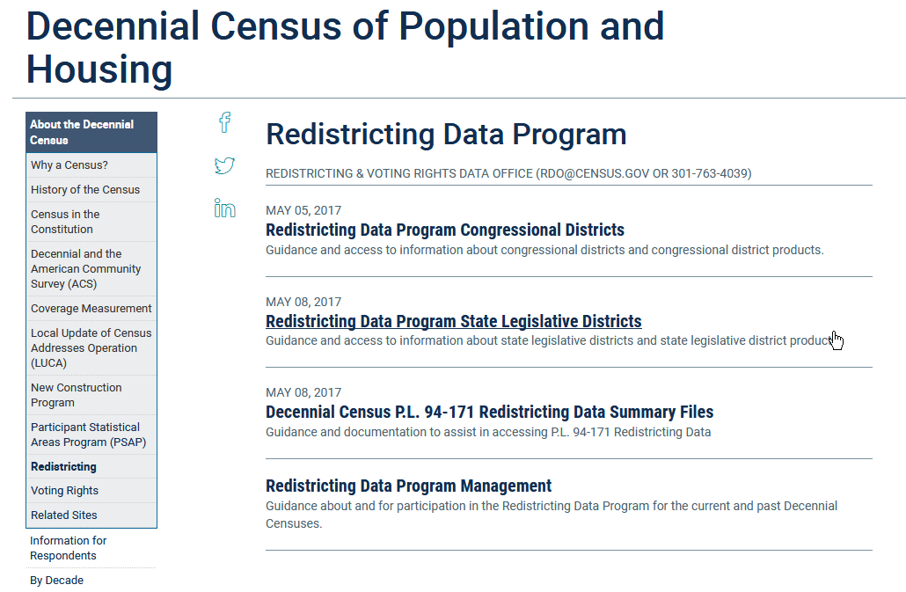
Where to get the data?
WWW.CENSUS.GOV/RDO
Voting Rights Data
Prototype Data
Official Data in 2021

Slide 10
Thank You
James Whitehorne
Chief – Redistricting & Voting Rights Data Office
U.S. Department of Commerce
U.S. Census Bureau
4600 Silver Hill Rd.
Suitland, Maryland 20746
Office: 301-763-4039
Email: rdo@census.gov
Website: www.census.gov/rdo

